Slide 1

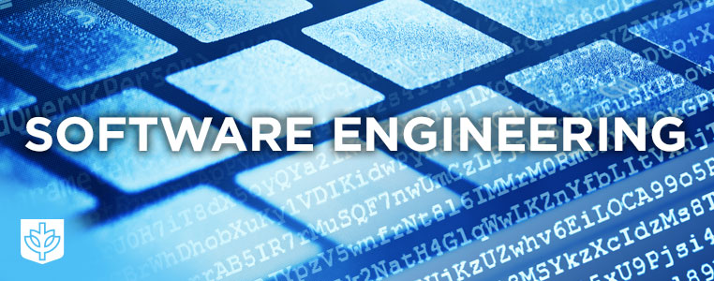
SE113
Lecture 4
Instructor:
Nusrat jahan
Lecturer, SWE, DIU.

Slide 2
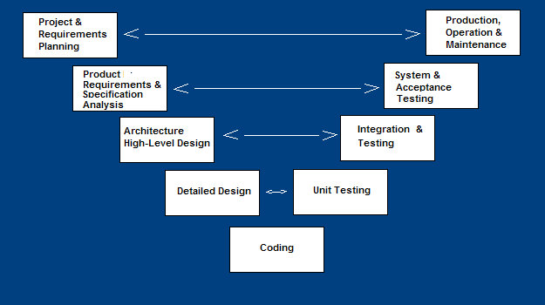
V- Model

Slide 3
V Model
A variant of the Waterfall that emphasizes the verification and validation of the product.
Testing of the product is planned in parallel with a corresponding phase of development

Slide 4
V Model
Project and Requirements Planning – allocate resources
Product Requirements and Specification Analysis – complete specification of the software system
Architecture or High-Level Design – defines how software functions fulfill the design
Detailed Design – develop algorithms for each architectural component
Production, operation and maintenance – provide for enhancement and corrections
System and acceptance testing – check the entire software system in its environment
Integration and Testing – check that modules interconnect correctly
Unit testing – check that each module acts as expected
Coding – transform algorithms into software

Slide 5
V-Shaped Strengths
Emphasize planning for verification and validation of the product in early stages of product development
Each deliverable must be testable
Project management can track progress by milestones
Easy to use

Slide 6
V-Shaped Weaknesses
Does not easily handle concurrent events
Does not handle iterations or phases
Does not easily handle dynamic changes in requirements
Does not contain risk analysis activities

Slide 7
When to use the V-Shaped Model
Excellent choice for systems requiring high reliability – hospital patient control applications
All requirements are known up-front
When it can be modified to handle changing requirements beyond analysis phase
Solution and technology are known

Slide 8
Thanks

